Slide 1


Mathematical Institute of the Serbian Academy of Sciences and Arts
Building a survey to develop Addressable Minds
Focus on rating questions, Elements & categories
Steve Onufrey
iNovum, LLC.

Slide 2
Agenda
1 Addressable Minds Flow – how it’s done
2 Survey – how panelists see it
3 Conjoint analysis
4 Element & categories: how to create and group messages for your survey
5 Loading and running a survey in IdeaMap

Slide 3



Create Addressable Minds messaging for potential students
IDENTIFY TARGET MARKET
DEVELOP SURVEY QUESTIONS
INTERNET
IdeaMap™
SUY
SURVEY
Potential Students
ANALYZED SURVEY RESULTS → Addressable Minds
MARKET SEGMENTATION
MARKETING PHRASES
TYPING ENGINE
3
Notes:
3

Slide 4
Create Addressable Minds messaging for potential students
IDENTIFY TARGET MARKET
DEVELOP SURVEY QUESTIONS
INTERNET
IdeaMap™
SUY
SURVEY
Potential Students
Experimental Design – Stimulus/Response
ANALYZED SURVEY RESULTS → Addressable Minds
Ordinary Least Squares Regression
Discriminant Function Analysis
Conjoint analysis
4
Notes:
4

Slide 5
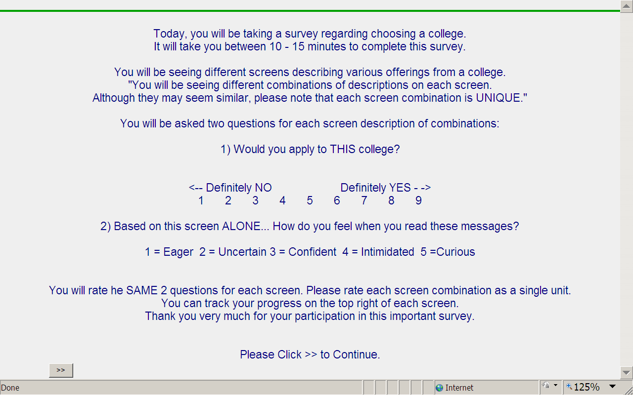
The Addressable Mind Study begins with an orientation screen
Rating
questions
5

Slide 6
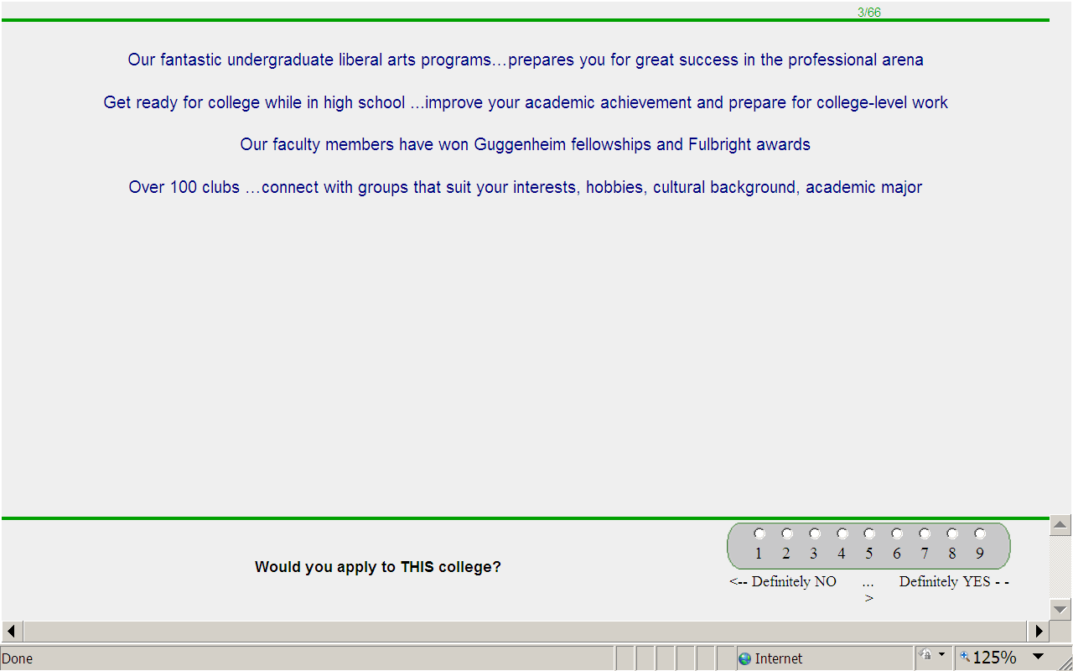
Each respondent evaluates 48 (6x6) or 40 (4x6) unique combinations of elements
First measures overall interest
Anchor Description and Scale
Rating question # 1
Elements (3-4 per screen)
6

Slide 7
Then identifies a single emotion
Rating question # 2
Elements
Emotions
7
7
Notes:
7

Slide 8
Conjoint Analysis
Quantitative method of marketing research
Determine how people value different features that make up a product/service. What combination is most appealing?
Rather than directly asking respondents what they prefer in a product, or what attributes they find important…. we evaluate multiple product features on each vignette (screen).

Slide 9

What is a Rating Question (1 of 3)?
It is the main question asked throughout the survey
Questions on which your concepts will be rated by survey-takers/consumers
Maximum two rating questions per survey:
1st – Interest and 2nd – Emotions

Slide 10
What is a Rating Question (2 of 3)?
Rating Question – Interest. Determined by a purpose or a business goal of the study.
How likely are you to buy this product/service?
How well does this describe you?
How interested are you in this offer?
How likely are you to enroll in this program?
How much would you donate to this cause/pay for this product or service?

Slide 11
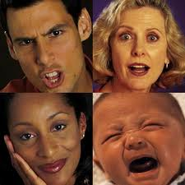
What is a Rating Question (3 of 3)?
Rating Question - Emotions
How do you feel when you read these messages?

Slide 12




What is a Rating Scale/Anchor Description?
The rating scale for questions in the IdeaMap.NET is fixed 1 to 9. Suggested anchor descriptions:
1 = Not at all likely. . . 9 = Very likely
1 = Not interested at all . . . 9 = Very interested
1 = Won’t donate 2 = $20 or less 3 = $30 4 = $40 5 = $50 or more
1 = Not at all. . . 9 = Very much
1 = Eager 2 = Interested 3 = Indifferent 4 = Curious 5 = Uncertain

Slide 13

What are categories (also referred to as “silos”)?
Categories used for organizing elements. Like different files in a filing cabinet, organizing or grouping similar statements (elements) in one place.
IdeaMap.Net chooses elements from different categories so two elements from the same category will never appear on the screen at the same time.
A study with 6 categories and 6 elements per silo typically gives the most flexibility and richest results.

Slide 14



What is an Element?
It is the single most important component of a project.
Elements are bite sized ways of talking about a product, service or an idea ("nuggets of information").
Respondents see each single element few times during the survey

Slide 15


Where do elements come from?
Brainstorming/Ideation – make them up
Current advertising/packaging or that of your competitors – use messages already available on the market

Slide 16
How to create elements? (1 of 3)
Elements should be stand-alone phrases, not single words or incomplete ideas!!
X Small, medium, large
V Comes in 3 different sizes…small, medium and large
Stay away from negative statements!!
X Because you’re fat
V It will help you achieve your ideal weight
Avoid Using Periods! It disrupts logical flow
X More than just a stylish car. This car is capable of turning heads.
V More than just a stylish car…capable of turning heads

Slide 17
How to create elements? (2 of 3)
Make elements sound personal, and concentrate on what consumers would want to hear!
X For wealthy people
V Because now you can afford it
Consistency!!! - All elements should be in the same tense, and in the same person. Try to stay away from first person
X I can’t believe it tastes so good
V You won’t believe how good it tastes!
Use short statements!! Max 25 words

Slide 18
How to create elements? (3 of 3)
Elements should convey a single thought
X Enjoy a great tasting chocolate shake available in a convenient on the go drink box
In this example either the flavor (chocolate) or the packaging (drink box) or both together can be the driving force
V Enjoy a great tasting chocolate shake
Available in a convenient on the go drink box

